Slide 1

Propositional Logic and Proof

Slide 2
Proposition
Definition
A proposition is a declarative sentence (that is, a sentence that declares a fact) that is either true or false, but not both.
Example
Washington, D.C., is the capital of the United States of America
Dhaka is the capital of Bangladesh
Dhaka is the capital of India
8 + 2 = 10
4 + 4 = 10

Slide 3
Proposition or Not?
What time is it?
Read this carefully.
a + 2 = 10
x + y = z

Slide 4
Propositional Variable
Definition
variables that represent propositions, just as letters are used to denote numerical variables.
The conventional letters used for propositional variables are p, q, r, s, ... .
Example :
p = Dhaka is the capital of Bangladesh.

Slide 5
Some common terms
The truth value
The truth value of a proposition is true, denoted by T, if it is a true proposition, and the truth value of a proposition is false, denoted by F, if it is a false proposition.
p = Dhaka is the capital of Bangladesh.
Truth value : T
p = Dhaka is the capital of Pakistan.
Truth value : F

Slide 6
Some common terms
Propositional Calculus or Propositional Logic.
The area of logic that deals with propositions is called the propositional calculus or propositional logic.
Compound Propositions
New propositions formed from existing propositions using logical operators are called compound propositions.

Slide 7
Introduction to Logical Operators
About a dozen logical operators
Similar to algebraic operators + * - /
Basic Operators
Negation (NOT)
Conjunction (AND)
Disjunction (OR)

Slide 8
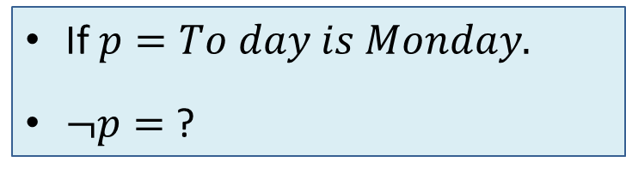
Logical operators: Not
Definition
A “not” operation switches (negates) the truth value.
Symbol: ¬ or ~
Truth table
P | ¬p
T | F
F | T
If $p=To day is Monday.$
$¬p=$ ?

Slide 9
Logical operators: And
Definition
An “and” operation is true if both operands are true.
Symbol: ∧
p | q | p∧q
T | T | T
T | F | F
F | T | F
F | F | F
p = “Today is Friday”
q = “Today is my birthday”
p∧q = ?
p∧q = “Today is Friday and today is my birthday”

Slide 10
Logical operators: Or
Definition
An “or” operation is true if either operands or both are true.
Symbol: ∨
p | q | p∨q
T | T | T
T | F | T
F | T | T
F | F | F
p = “Today is Friday”
q = “Today is my birthday”
p ∨ q = ?
p ∨ q = “Today is Friday or today is my birthday”

Slide 11
More Logical Operators
More Operators
Exclusive OR
Conditional
Bicondition

Slide 12
Logical operators: Exclusive Or
Definition
Let p and q be propositions. The exclusive or of p and q, denoted by p⊕q, is the proposition that is true when exactly one of p and q is true and is false otherwise.
Symbol: ⊕
Often called XOR
p⊕q ≡ (p ∨ q) ∧ ¬(p ∧ q)
p | q | p⊕q
T | T | F
T | F | T
F | T | T
F | F | F
p⊕q = “Today is Friday or today is my birthday, but not both”

Slide 13
Logical operators: Conditional
Definition
Let p and q be propositions. The conditional statement p→q is the proposition “if p, then q.” The conditional statement p→q is false when p is true and q is false, and true otherwise.
p implies q
If p, q
p only if q
p is sufficient for q
q if p
q whenever p
q is necessary for p
p→q = “If today is Friday, then today is my birthday”
In the conditional statement p→q,
p is called the hypothesis (or antecedent or premise)
q is called the conclusion (or consequence)

Slide 14
Logical operators: Conditional
p → q = ¬p∨ q
p | q | p→q
T | T | T
T | F | F
F | T | T
F | F | T
the
antecedent
the
consequence
I will do only for myself
Let, p = “Maria learns discrete mathematics” and
q = “Maria will find a good job.”
Express the statement p→q as a statement in English.
If I am elected, then I will lower taxes.

Slide 15
Logical operators: Bi-Conditional
Definition
Let p and q be propositions. The biconditional statement p↔q is the proposition “p if and only if q.” The biconditional statement p↔q is true when p and q have the same truth values, and is false otherwise.
Biconditional statements are also called bi-implications.
“p is necessary and sufficient for q”
“if p then q, and conversely”
“p iff q.”

Slide 16
Logical operators: Bi-Conditional
True when both has same truth values and otherwise false.
p | q | p↔q
T | T | T
T | F | F
F | T | F
F | F | T
Alternatively, it means “(if p then q) and (if q then p)” (p→q)∧ (q→p).
Note that a bi-conditional has the opposite truth values of the exclusive or
Let p = “You take this class” and q = “You get a grade”
p↔q = “You take this class if and only if you get a grade”
Alternatively, it means “If you take this class, then you get a grade and if you get a grade then you take (took) this class”

Slide 17
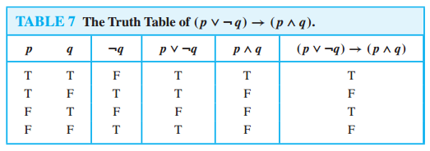
Truth Tables of Compound Propositions
Example
Construct the truth table of the compound proposition
(p∨¬q)→(p∧q).

Slide 18
Boolean operators summary
 |  | and | or | xor | conditional | Bi-conditional
p | q | p∧q | p∨q | p⊕q | p→q | p↔q
T | T | T | T | F | T | T
T | F | F | T | T | F | F
F | T | F | T | T | T | F
F | F | F | F | F | T | T
Learn what they mean, don’t just memorize the table!

Slide 19

Precedence of operators
Just as in algebra, operators have precedence
4+3*2 = ?
4+3*2 = 4+(3*2)
4+3*2 = (4+3)*2

Slide 20
Precedence of operators
p ∨ q ∧ ¬r → s ↔ t = ?
=(p ∨ (q ∧ (¬r)) → s) ↔ (t)
First three are the most important
Not is always performed before any other operation
Operators | Precedence
¬ | 1
∧ | 2
∨ | 3
→ | 4
↔ | 5

Slide 21
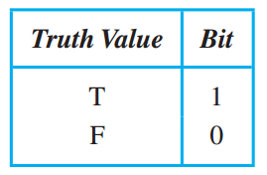
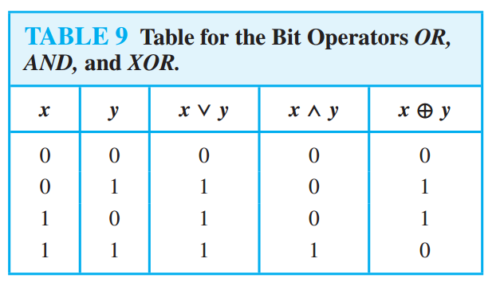
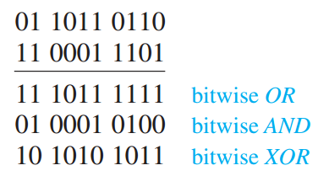
Logic and Bit Operations

Slide 22
Applications of Propositional Logic
Translating English Sentences
System Specifications
Boolean Searches
Logic Puzzles
Logic Circuits

Slide 23
Translating English Sentences
Example
p = “It is below freezing”
q = “It is snowing”
It is below freezing and it is snowing
p∧q
It is below freezing but not snowing
p∧¬q
If it is below freezing, it is also snowing
p→q
It is either below freezing or it is snowing, but it is not snowing if it is below freezing
(p∨q)∧(p→¬q)
That it is below freezing is necessary and sufficient for it to be snowing
p↔q

Slide 24
Translating English Sentences
Problem: How can this English sentence be translated into a logical expression?
“You can access the Internet from campus only if you are a computer science major or you are not a freshman.”
Solve:
Let, a = “You can access the Internet from campus,”
c = “You are a computer science major,” and
f = “You are a freshman,”
Then the statement can be represented as a → (c ∨ ¬f).

Slide 25
Translating English Sentences
Problem: How can this English sentence be translated into a logical expression?
“You can access the Internet from campus only if you are a computer science major or you are not a freshman.”
Solve:
Let, a = “You can access the Internet from campus,”
c = “You are a computer science major,” and
f = “You are a freshman,”
Then the statement can be represented as a → (c ∨ ¬f).

Slide 26
Translating English Sentences
How can this English sentence be translated into a logical expression?
“You can not ride the roller coaster if you are under 4 feet tall unless you are older than 16 years old.”
Solution: Let q, r, and s represent “You can ride the roller coaster,” “You are under 4 feet tall,” and “You are older than 16 years old,” respectively. Then the sentence can be translated to (r ∧ ¬s) → ¬q.

Slide 27

Propositional Equivalences
Back to the $¬$Future

Slide 28

Back to the $¬$Future
Propositional Calculus or Propositional Logic.
The area of logic that deals with propositions is called the propositional calculus or propositional logic.
Compound Propositions
New propositions formed from existing propositions using logical operators are called compound propositions.

Slide 29
Some Common Terms
Tautology
A compound proposition that is always true, no matter what the truth values of the propositional variables that occur in it, is called a tautology.
Contradiction
A compound proposition that is always false is called a contradiction.
Contingency
A compound proposition that is neither a tautology nor a contradiction is called a contingency.

Slide 30
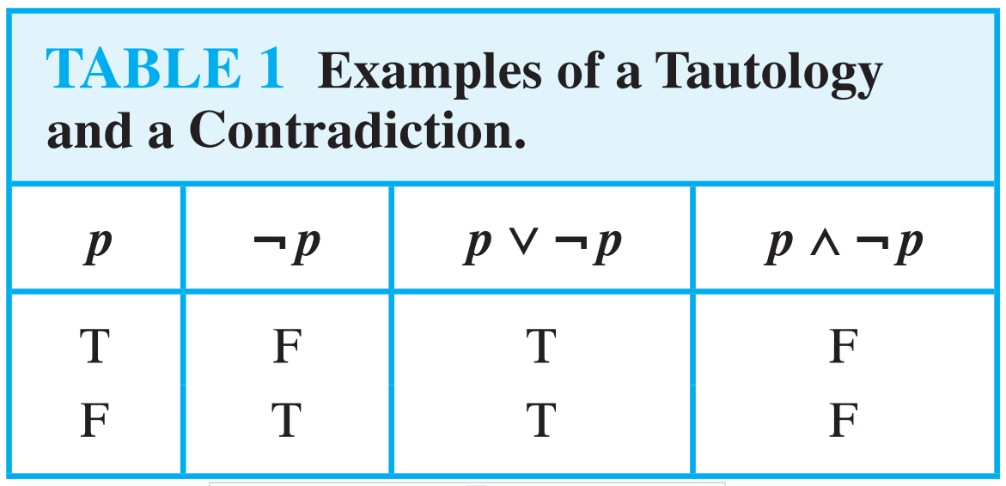
Example
Tautology
p ∨ ¬p
Contradiction
p ∧ ¬p
Contingency
p → ¬p

Slide 31
Tautology
Demonstrate that
[¬p ∧(p ∨q )]→q
is a tautology in two ways:
Using a truth table – show that [¬p ∧(p ∨q )]→q is always true
Using a proof (will get to this later).

Slide 32
Tautology by truth table
p | q | ¬p | p ∨q | ¬p ∧(p ∨q ) | [¬p ∧(p ∨q )]→q
T | T
T | F
F | T
F | F

Slide 33
Tautology by truth table
p | q | ¬p | p ∨q | ¬p ∧(p ∨q ) | [¬p ∧(p ∨q )]→q
T | T | F
T | F | F
F | T | T
F | F | T

Slide 34
Tautology by truth table
p | q | ¬p | p ∨q | ¬p ∧(p ∨q ) | [¬p ∧(p ∨q )]→q
T | T | F | T
T | F | F | T
F | T | T | T
F | F | T | F

Slide 35
Tautology by truth table
p | q | ¬p | p ∨q | ¬p ∧(p ∨q ) | [¬p ∧(p ∨q )]→q
T | T | F | T | F
T | F | F | T | F
F | T | T | T | T
F | F | T | F | F

Slide 36
Tautology by truth table
p | q | ¬p | p ∨q | ¬p ∧(p ∨q ) | [¬p ∧(p ∨q )]→q
T | T | F | T | F | T
T | F | F | T | F | T
F | T | T | T | T | T
F | F | T | F | F | T

Slide 37
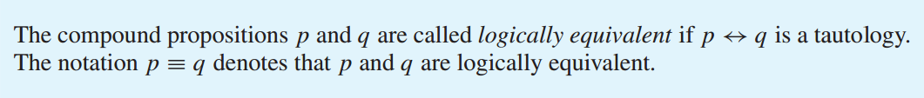
Propositional Equivalences
Definition
Compound propositions that have the same truth values in all possible cases are called logically equivalent.

Slide 38
Propositional Equivalences : How to Prove?
Two methods:
Using truth tables
Not good for long formula
In this course, only allowed if specifically stated!
Using the logical equivalences
The preferred method
p →q ≡ ¬q→¬p
(p → r) ∨ (q → r) ≡ (p ∧ q) → r

Slide 39
Logical Equivalence Using Truth Table
The easiest way to check for logical equivalence is to see if the truth tables of both variants have
identical last columns. (p →q ≡ ¬q→¬p)
p
q
p →q
p
q
¬q
¬p
¬q→¬p

Slide 40
Logical Equivalence Using Truth Table
The easiest way to check for logical equivalence is to see if the truth tables of both variants have identical last columns:
p
q
p →q
p
q
¬q
¬p
¬q→¬p
T
T
F
F
T
F
T
F
T
F
T
T

Slide 41
Logical Equivalence Using Truth Table
The easiest way to check for logical equivalence is to see if the truth tables of both variants have identical last columns:
p
q
p →q
p
q
¬q
¬p
¬q→¬p
T
T
F
F
T
F
T
F
T
F
T
T
T
T
F
F
T
F
T
F

Slide 42
Logical Equivalence Using Truth Table
The easiest way to check for logical equivalence is to see if the truth tables of both variants have identical last columns:
p
q
p →q
p
q
¬q
¬p
¬q→¬p
T
T
F
F
T
F
T
F
T
F
T
T
T
T
F
F
T
F
T
F
F
T
F
T

Slide 43
Logical Equivalence Using Truth Table
The easiest way to check for logical equivalence is to see if the truth tables of both variants have identical last columns:
p
q
p →q
p
q
¬q
¬p
¬q→¬p
T
T
F
F
T
F
T
F
T
F
T
T
T
T
F
F
T
F
T
F
F
T
F
T
F
F
T
T

Slide 44
Logical Equivalence Using Truth Table
The easiest way to check for logical equivalence is to see if the truth tables of both variants have identical last columns:
p
q
p →q
p
q
¬q
¬p
¬q→¬p
T
T
F
F
T
F
T
F
T
F
T
T
T
T
F
F
T
F
T
F
F
T
F
T
F
F
T
T
T
F
T
T

Slide 45
Propositional Equivalences : How to Prove?
Two methods:
Using truth tables
Not good for long formula
In this course, only allowed if specifically stated!
Using the logical equivalences
The preferred method
p →q ≡ ¬q→¬p
(p → r) ∨ (q → r) ≡ (p ∧ q) → r

Slide 46
Truth Table Solution
(p → r) ∨ (q → r) ≡ (p ∧ q) → r
p | q | r | p→r | q →r | p∧q | (p→r)∨(q →r) | (p∧q) →r
T | T | T | T | T | T | T | T
T | T | F | F | F | T | F | F
T | F | T | T | T | F | T | T
T | F | F | F | T | F | T | T
F | T | T | T | T | F | T | T
F | T | F | T | F | F | T | T
F | F | T | T | T | F | T | T
F | F | F | T | T | F | T | T

Slide 47
Logical Equivalences
p ∧ T ≡ p p ∨ F ≡ p | Identity Laws | (p ∨ q) ∨ r ≡ p ∨ (q ∨ r) (p ∧ q) ∧ r ≡ p ∧ (q ∧ r) | Associative laws
p ∨ T ≡ T p ∧ F ≡ F | Domination Law | p ∨ (q ∧ r) ≡ (p ∨ q) ∧ (p ∨ r) p ∧ (q ∨ r) ≡ (p ∧ q) ∨ (p ∧ r) | Distributive laws
p ∨ p ≡ p p ∧ p ≡ p | Idempotent Laws | ¬ (p ∧ q) ≡ ¬ p ∨ ¬ q ¬ (p ∨ q) ≡ ¬ p ∧ ¬ q | De Morgan’s laws
¬(¬ p) ≡ p | Double negation law | p ∨ (p ∧ q) ≡ p p ∧ (p ∨ q) ≡ p | Absorption laws
p ∨ q ≡ q ∨ p p ∧ q ≡ q ∧ p | Commutative Laws | p ∨ ¬ p ≡ T p ∧ ¬ p ≡ F | Negation lows
p→q ≡ ¬p∨q | Definition of Implication | p ↔ q ≡ (p → q) ∧ (q → p) | Definition of Biconditional

Slide 48
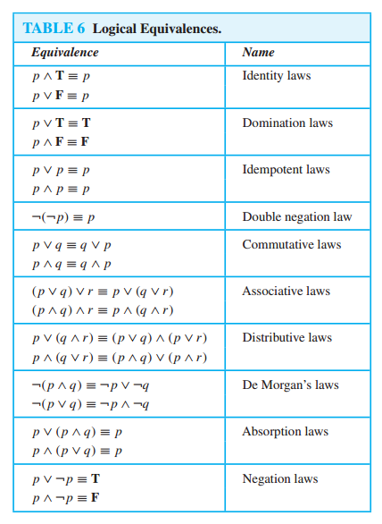
Logical Equivalences

Slide 49
Proof using Logical Equivalence
(p → r) ∨ (q → r)
≡ (p ∧ q) → r
≡ (¬ p ∨ r) ∨ (¬ q ∨ r)
≡ ¬ p ∨ r ∨ ¬ q ∨ r
≡ ¬ p ∨ ¬ q ∨ r ∨ r
≡ (¬ p ∨ ¬ q) ∨ (r ∨ r)
≡ ¬ (p ∧ q) ∨ r
Definition of implication
Associative
Commutative
Associative
De Morgan, Idempotent
Definition of implication

Slide 50
Example
Logical Equivalences : Example
Show that (p ∧ q) → (p ∨ q) is a Tautology. (Proof)
(p ∧ q) → (p ∨ q)
≡¬ (p ∧ q) ∨ (p ∨ q) Implication
≡ (¬ p ∨ ¬ q) ∨ (p ∨ q) De Morgan
≡ (¬ p ∨ p) ∨ (¬ q ∨ q) Commutative, Associative
≡ T ∨ T Negation
≡ T Identity

Slide 51
Tautology by proof
Tautology by proof
[¬p ∧(p ∨q )]→q
⇔ [(¬p ∧p)∨(¬p ∧q)]→q Distributive

Slide 52
Tautology by proof
Tautology by proof
[¬p ∧(p ∨q )]→q
⇔ [(¬p ∧p)∨(¬p ∧q)]→q Distributive
⇔ [ F ∨ (¬p ∧q)]→q ULE

Slide 53
Tautology by proof
Tautology by proof
[¬p ∧(p ∨q )]→q
⇔ [(¬p ∧p)∨(¬p ∧q)]→q Distributive
⇔ [ F ∨ (¬p ∧q)]→q ULE
⇔ [¬p ∧q ]→q Identity

Slide 54
Tautology by proof
Tautology by proof
[¬p ∧(p ∨q )]→q
⇔ [(¬p ∧p)∨(¬p ∧q)]→q Distributive
⇔ [ F ∨ (¬p ∧q)]→q ULE
⇔ [¬p ∧q ]→q Identity
⇔ ¬ [¬p ∧q ] ∨ q ULE

Slide 55
Tautology by proof
Tautology by proof
[¬p ∧(p ∨q )]→q
⇔ [(¬p ∧p)∨(¬p ∧q)]→q Distributive
⇔ [ F ∨ (¬p ∧q)]→q ULE
⇔ [¬p ∧q ]→q Identity
⇔ ¬ [¬p ∧q ] ∨ q ULE
⇔ [¬(¬p)∨ ¬q ] ∨ q DeMorgan

Slide 56
Tautology by proof
Tautology by proof
[¬p ∧(p ∨q )]→q
⇔ [(¬p ∧p)∨(¬p ∧q)]→q Distributive
⇔ [ F ∨ (¬p ∧q)]→q ULE
⇔ [¬p ∧q ]→q Identity
⇔ ¬ [¬p ∧q ] ∨ q ULE
⇔ [¬(¬p)∨ ¬q ] ∨ q DeMorgan
⇔ [p ∨ ¬q ] ∨ q Double Negation

Slide 57
Tautology by proof
Tautology by proof
[¬p ∧(p ∨q )]→q
⇔ [(¬p ∧p)∨(¬p ∧q)]→q Distributive
⇔ [ F ∨ (¬p ∧q)]→q ULE
⇔ [¬p ∧q ]→q Identity
⇔ ¬ [¬p ∧q ] ∨ q ULE
⇔ [¬(¬p)∨ ¬q ] ∨ q DeMorgan
⇔ [p ∨ ¬q ] ∨ q Double Negation
⇔ p ∨ [¬q ∨q ] Associative

Slide 58
Tautology by proof
Tautology by proof
[¬p ∧(p ∨q )]→q
⇔ [(¬p ∧p)∨(¬p ∧q)]→q Distributive
⇔ [ F ∨ (¬p ∧q)]→q ULE
⇔ [¬p ∧q ]→q Identity
⇔ ¬ [¬p ∧q ] ∨ q ULE
⇔ [¬(¬p)∨ ¬q ] ∨ q DeMorgan
⇔ [p ∨ ¬q ] ∨ q Double Negation
⇔ p ∨ [¬q ∨q ] Associative
⇔ p ∨ [q ∨¬q ] Commutative

Slide 59
Tautology by proof
Tautology by proof
[¬p ∧(p ∨q )]→q
⇔ [(¬p ∧p)∨(¬p ∧q)]→q Distributive
⇔ [ F ∨ (¬p ∧q)]→q ULE
⇔ [¬p ∧q ]→q Identity
⇔ ¬ [¬p ∧q ] ∨ q ULE
⇔ [¬(¬p)∨ ¬q ] ∨ q DeMorgan
⇔ [p ∨ ¬q ] ∨ q Double Negation
⇔ p ∨ [¬q ∨q ] Associative
⇔ p ∨ [q ∨¬q ] Commutative
⇔ p ∨ T ULE

Slide 60
Tautology by proof
Tautology by proof
[¬p ∧(p ∨q )]→q
⇔ [(¬p ∧p)∨(¬p ∧q)]→q Distributive
⇔ [ F ∨ (¬p ∧q)]→q ULE
⇔ [¬p ∧q ]→q Identity
⇔ ¬ [¬p ∧q ] ∨ q ULE
⇔ [¬(¬p)∨ ¬q ] ∨ q DeMorgan
⇔ [p ∨ ¬q ] ∨ q Double Negation
⇔ p ∨ [¬q ∨q ] Associative
⇔ p ∨ [q ∨¬q ] Commutative
⇔ p ∨ T ULE
⇔ T Domination

Slide 61
What can’t we say?
Quantification: every student has a father.
Relations: If X is married to Y, then Y is married to X.
Probability: There is an 80% chance of rain.
Combine Evidence: This car is better than that one because…
Uncertainty: Maybe John is playing golf.

Slide 62
Predicates (Propositional Function) and Quantifiers

Slide 63
Predicates (Propositional Function)
So far we can represent the statement – “10 > 100” or “10 <= 100”
But we can’t represent - “x > 3,” “x = y + 3,” “x + y = z,”
Can represent – “Jorna knows C programming.”
Can’t represent – “X knows C programming.”
Can’t represent – “Every student know C programming.”
Can’t represent – “At least one student know C programming.”

Slide 64
Predicates : “x is greater than 3”
“x is greater than 3” has two parts
“x is greater than 3” – the variable x, is the subject of the statement.
“x is greater than 3” – the predicate, refers to a property that the subject of the statement can have.
We can denote the statement “x is greater than 3” by P(x),
Where P denotes the predicate “is greater than 3” and
x is the variable.

Slide 65
Predicates : “x is greater than 3”
We can denote the statement “x is greater than 3” by P(x),
Where P denotes the predicate “is greater than 3” and
x is the variable.
The statement P(x) is also said to be the value of the propositional function P at x.
Once a value has been assigned to the variable x, the statement P(x) becomes a proposition and has a truth value.
Q: Let P(x) denote the statement “x > 3.” What are the truth values of P(4) and P(2)?

Slide 66
Predicates : Some Example
Example 1
Let Q(x, y) denote the statement “x = y + 3.” What are the truth values of the propositions Q(1, 2)and Q(3, 0)?
Example 3
Let R(x, y, z) denote the statement “x + y = z.” What are the truth values of the propositions R(1,2,3) and R(0,0,1)?

Slide 67
Quantifiers
What is it?
Quantification is a way to create a proposition from a propositional function (predicate).
Quantification expresses the extent to which a predicate is true over a range of elements.
English words all, some, many, none, and few are used in quantifications.

Slide 68
Quantifiers : Types
THE UNIVERSAL QUANTIFIER
THE EXISTENTIAL QUANTIFIER

Slide 69
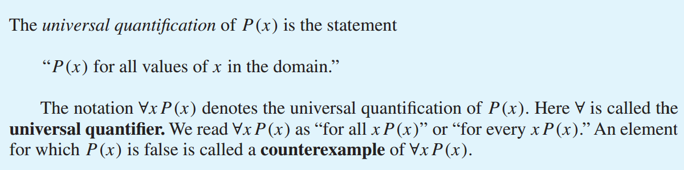
The Universal Quantifier
Definition

Slide 70
The Universal Quantifier : True/False?
Statement | When True? | When False?
∀x P(x) | P(x) is true for every x | There is an x for which P(x) is false.
P(x) = “Student x knows C programming.”
Domain : This Class!
When true?
If every student knows programming
When false?
If a least one student does not know

Slide 71
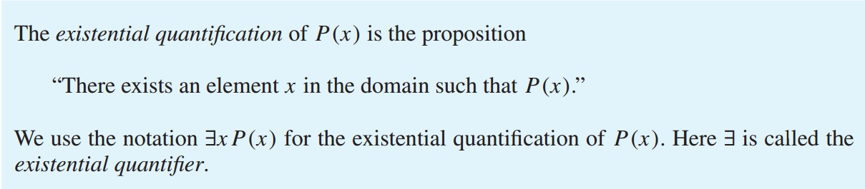
The Existential Quantifier
Definition

Slide 72
The Existential Quantifier : True/False?
Statement | When True? | When False?
∃x P(x) | There is an x for which P(x) is true. | P(x) is false for every x.
P(x) = “Student x knows C programming.”
Domain : This Class!
When true?
If at least one student knows programming
When false?
If a every student does not know

Slide 73
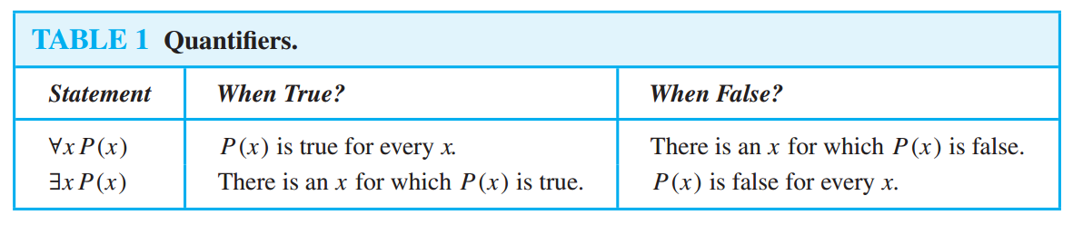
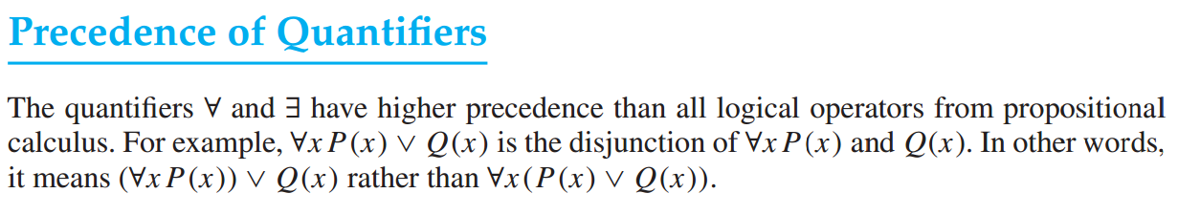
Summarize

Slide 74
Quantifiers : Example
Let Q(x) be the statement “x < 2.” What is the truth value of the quantification ∀x Q(x), where the domain consists of all real numbers?
Solution : Q(x) is not true for every real number x, because, for instance, Q(3) is false. That is, x = 3 is a counter example for the statement ∀x Q(x). Thus ∀x Q(x) is false.
Let P(x) denote the statement “x > 3”. What is the truth value of the quantification ∃x P (x), where the domain consists of all real numbers?
Solution : Because “ x > 3” is sometimes true—for instance, when x = 4, the existential quantification of P(x), which is ∃x P(x), is true.

Slide 75
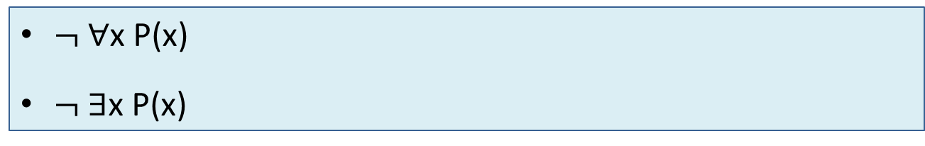
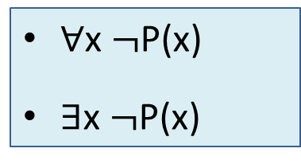
Negating Quantified Expressions
P(x) = “Student x in your class has taken a course in calculus.”
∀x P(x) = “Every student in your class has taken a course in calculus.”
∃x P(x) = “At least one student in this class has taken a course in calculus.”
∀x $¬$P(x)
∃x $¬$P(x)
$¬$∀x P(x)
$¬$∃x P(x)

Slide 76
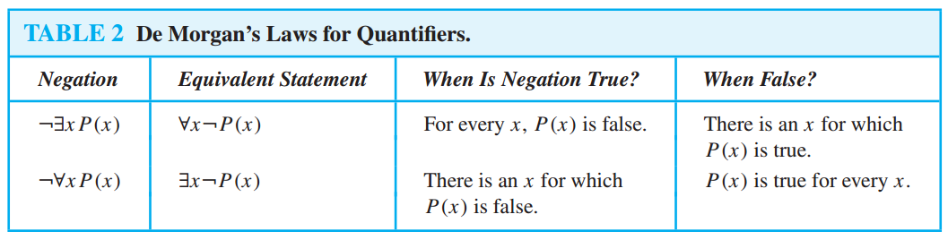
Negating Quantified Expressions

Slide 77
Applications Area
Translating English Sentences
System Specifications
Boolean Searches
Logic Puzzles
Logic Circuits

Slide 78
Translating English Sentences
Express the statement “Every student in this class has studied calculus” using predicates and quantifiers.
Rewrite: “For every student in this class, that student has studied calculus.”
Use variable x : “For every student x in this class, x has studied calculus.”
C(x), which is the statement “x has studied calculus.”
∀x C(x) [OK, if the domain for x consists of the students in the class]

Slide 79
Translating English Sentences
Express the statement “Every student in this class has studied calculus” using predicates and quantifiers.
“For every person x, if person x is a student in this class then x has studied calculus.”
If S(x) represents the statement that person x is in this class.
∀x (S(x) → C(x))

Slide 80
Multivariable Predicates
M(X, Y) : X has emailed Y
∀X ∀Y M(X, Y)
∀X ∃Y M(X, Y)
∃X ∀Y M(X, Y)
∃X ∃Y M(X, Y)

Slide 81
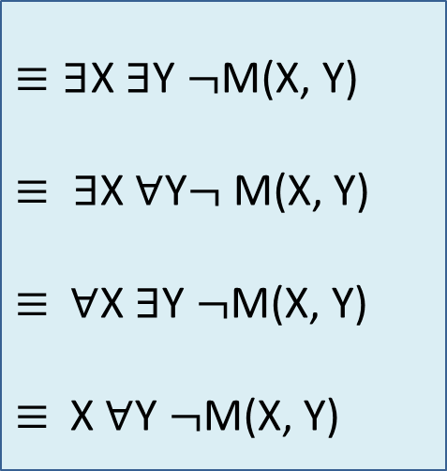
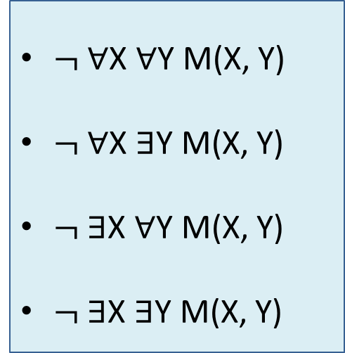
Multi Variable Quantifier Negation
M(X, Y) : X has emailed Y
$¬$∀X ∀Y M(X, Y)
$¬$∀X ∃Y M(X, Y)
$¬$∃X ∀Y M(X, Y)
$¬$∃X ∃Y M(X, Y)
$≡\text{∃}$X ∃Y $¬$M(X, Y)
$≡ ∃$X $∀$Y$¬$M(X, Y)
$≡$$∀$X $∃$Y $¬$M(X, Y)
$≡$X $∀$Y $¬$M(X, Y)
∃

Slide 82


Multi Variable Quantifier Negation
De-Morgans Law
$$¬∀x ∀y P\left(x,y\right) ⋀Q\left(x,y\right)$$
$$≡∃x ∃y ¬p(x,y)⋁¬Q(x,y)$$

Slide 83
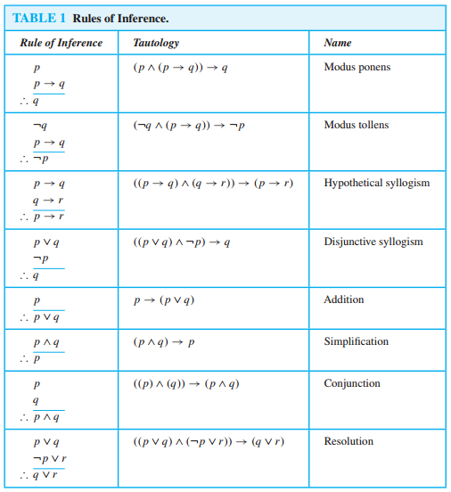
Rules of Inference
Example from Book!!!

Slide 84
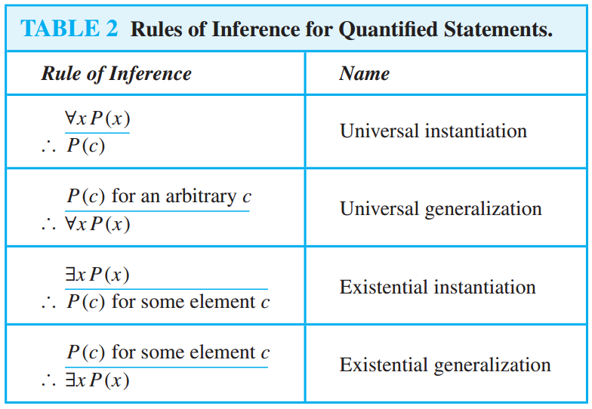
Rules of Inference for Quantified Statements
Example from Book!!!

Slide 85


Fallacy
Looks OK but Not OK!!!
$$P→Q$$
$$¬p$$
$$∴¬Q$$
$$P→Q$$
$$Q$$
$$∴P$$

Slide 86
Proof Techniques

Slide 87
Some Terminology
lemma
A less important theorem that is helpful in the proof of other results is called a lemma.
Proof
A proof is a valid argument that establishes the truth of a theorem.

Slide 88
Some Terminology
Theorem
A theorem is a statement that can be shown to be true. In mathematical writing, the term theorem is usually reserved for a statement that is considered at least somewhat important.
Propositions
Less important theorems sometimes are called propositions.

Slide 89
Proof Techniques
General Techniques
Direct Proof
Proof by Contraposition (Indirect Proof)
Proof by Contradiction
The square of an even number is even.

Slide 90
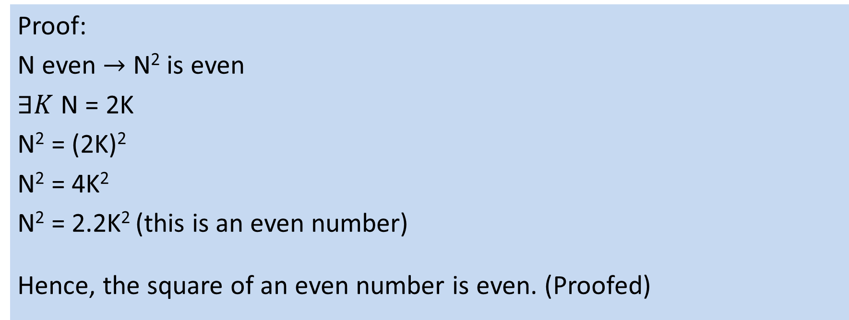
The square of an even number is even.
Direct Proof $[P→Q]$
Proof:
N even $→$ N² is even
$∃K$ N = 2K
N² = (2K)²
N² = 4K²
N² = 2.2K² (this is an even number)
Hence, the square of an even number is even. (Proofed)

Slide 91
Proof Techniques
Proof by Contraposition $[P→Q ≡ ¬Q→¬P]$
Sometime we can not provide direct proof.
If N² is even then N is even.

Slide 92
The square of an even number is even (Indirect Proof )
PROVE: The square of an even number is even. (Ex. 1.16.b)
Suppose k ² is not even.

Slide 93
The square of an even number is even (Indirect Proof )
PROVE: The square of an even number is even. (Ex. 1.16.b)
Suppose k ² is not even.
So k ² is odd.

Slide 94
The square of an even number is even (Indirect Proof )
PROVE: The square of an even number is even. (Ex. 1.16.b)
Suppose k ² is not even.
So k ² is odd.
∃n k ² = 2n + 1

Slide 95
The square of an even number is even (Indirect Proof )
PROVE: The square of an even number is even. (Ex. 1.16.b)
Suppose k ² is not even.
So k ² is odd.
∃n k ² = 2n + 1
∃n k ² - 1 = 2n

Slide 96
The square of an even number is even (Indirect Proof )
PROVE: The square of an even number is even. (Ex. 1.16.b)
Suppose k ² is not even.
So k ² is odd.
∃n k ² = 2n + 1
∃n k ² - 1 = 2n
∃n (k - 1)(k + 1) = 2n

Slide 97
The square of an even number is even (Indirect Proof )
PROVE: The square of an even number is even. (Ex. 1.16.b)
Suppose k ² is not even.
So k ² is odd.
∃n k ² = 2n + 1
∃n k ² - 1 = 2n
∃n (k - 1)(k + 1) = 2n
(k - 1)(k + 1) | 2 = n

Slide 98
The square of an even number is even (Indirect Proof )
PROVE: The square of an even number is even. (Ex. 1.16.b)
Suppose k ² is not even.
So k ² is odd.
∃n k ² = 2n + 1
∃n k ² - 1 = 2n
∃n (k - 1)(k + 1) = 2n
(k - 1)(k + 1) | 2 = n
(k - 1) | 2 ∨ (k + 1) | 2 since 2 is prime

Slide 99
The square of an even number is even (Indirect Proof )
PROVE: The square of an even number is even. (Ex. 1.16.b)
Suppose k ² is not even.
So k ² is odd.
∃n k ² = 2n + 1
∃n k ² - 1 = 2n
∃n (k - 1)(k + 1) = 2n
(k - 1)(k + 1) | 2 = n
(k - 1) | 2 ∨ (k + 1) | 2 since 2 is prime
∃a k - 1 = 2a ∨ ∃b k+1 = 2b

Slide 100
The square of an even number is even (Indirect Proof )
PROVE: The square of an even number is even. (Ex. 1.16.b)
Suppose k ² is not even.
So k ² is odd.
∃n k ² = 2n + 1
∃n k ² - 1 = 2n
∃n (k - 1)(k + 1) = 2n
(k - 1)(k + 1) | 2 = n
(k - 1) | 2 ∨ (k + 1) | 2 since 2 is prime
∃a k - 1 = 2a ∨ ∃b k+1 = 2b
∃a k = 2a + 1 ∨ ∃b k = 2b – 1

Slide 101
The square of an even number is even (Indirect Proof )
PROVE: The square of an even number is even. (Ex. 1.16.b)
Suppose k ² is not even.
So k ² is odd.
∃n k ² = 2n + 1
∃n k ² - 1 = 2n
∃n (k - 1)(k + 1) = 2n
(k - 1)(k + 1) | 2 = n
(k - 1) | 2 ∨ (k + 1) | 2 since 2 is prime
∃a k - 1 = 2a ∨ ∃b k+1 = 2b
∃a k = 2a + 1 ∨ ∃b k = 2b – 1
In both cases k is odd

Slide 102
The square of an even number is even (Indirect Proof )
PROVE: The square of an even number is even. (Ex. 1.16.b)
Suppose k ² is not even.
So k ² is odd.
∃n k ² = 2n + 1
∃n k ² - 1 = 2n
∃n (k - 1)(k + 1) = 2n
(k - 1)(k + 1) | 2 = n
(k - 1) | 2 ∨ (k + 1) | 2 since 2 is prime
∃a k - 1 = 2a ∨ ∃b k+1 = 2b
∃a k = 2a + 1 ∨ ∃b k = 2b – 1
In both cases k is odd
So k is not even

Slide 103
Direct Proof : Example
PROVE: ∀k∈Z k ≡1(mod 3) → k ³≡1(mod 9)

Slide 104
Direct Proof : Example
PROVE: ∀k∈Z k ≡1(mod 3) → k ³≡1(mod 9)
k ≡1(mod 3)

Slide 105
Direct Proof : Example
PROVE: ∀k∈Z k ≡1(mod 3) → k ³≡1(mod 9)
k ≡1(mod 3)
∃n k-1 = 3n

Slide 106
Direct Proof : Example
PROVE: ∀k∈Z k ≡1(mod 3) → k ³≡1(mod 9)
k ≡1(mod 3)
∃n k-1 = 3n
∃n k = 3n + 1

Slide 107
Direct Proof : Example
PROVE: ∀k∈Z k ≡1(mod 3) → k ³≡1(mod 9)
k ≡1(mod 3)
∃n k-1 = 3n
∃n k = 3n + 1
∃n k ³ = (3n + 1)³

Slide 108
Direct Proof : Example
PROVE: ∀k∈Z k ≡1(mod 3) → k ³≡1(mod 9)
k ≡1(mod 3)
∃n k-1 = 3n
∃n k = 3n + 1
∃n k ³ = (3n + 1)³
∃n k ³ = 27n ³ + 27n ² + 9n + 1

Slide 109
Direct Proof : Example
PROVE: ∀k∈Z k ≡1(mod 3) → k ³≡1(mod 9)
k ≡1(mod 3)
∃n k-1 = 3n
∃n k = 3n + 1
∃n k ³ = (3n + 1)³
∃n k ³ = 27n ³ + 27n ² + 9n + 1
∃n k ³-1 = 27n ³ + 27n ² + 9n

Slide 110
Direct Proof : Example
PROVE: ∀k∈Z k ≡1(mod 3) → k ³≡1(mod 9)
k ≡1(mod 3)
∃n k-1 = 3n
∃n k = 3n + 1
∃n k ³ = (3n + 1)³
∃n k ³ = 27n ³ + 27n ² + 9n + 1
∃n k ³-1 = 27n ³ + 27n ² + 9n
∃n k ³-1 = (3n ³ + 3n ² + n)·9

Slide 111
Direct Proof : Example
PROVE: ∀k∈Z k ≡1(mod 3) → k ³≡1(mod 9)
k ≡1(mod 3)
∃n k-1 = 3n
∃n k = 3n + 1
∃n k ³ = (3n + 1)³
∃n k ³ = 27n ³ + 27n ² + 9n + 1
∃n k ³-1 = 27n ³ + 27n ² + 9n
∃n k ³-1 = (3n ³ + 3n ² + n)·9
∃m k ³-1 = m·9

Slide 112
Direct Proof : Example
PROVE: ∀k∈Z k ≡1(mod 3) → k ³≡1(mod 9)
k ≡1(mod 3)
∃n k-1 = 3n
∃n k = 3n + 1
∃n k ³ = (3n + 1)³
∃n k ³ = 27n ³ + 27n ² + 9n + 1
∃n k ³-1 = 27n ³ + 27n ² + 9n
∃n k ³-1 = (3n ³ + 3n ² + n)·9
∃m k ³-1 = m·9
k ³≡1(mod 9)

